Slide 1
Deep History Of the Study of Haptic Perception
By: Ahmed Nadeem

Slide 2


Slide 3


Slide 4
Background Color indicates progression through time
BCE and Middle ages
Recent History
Present Day

Slide 5



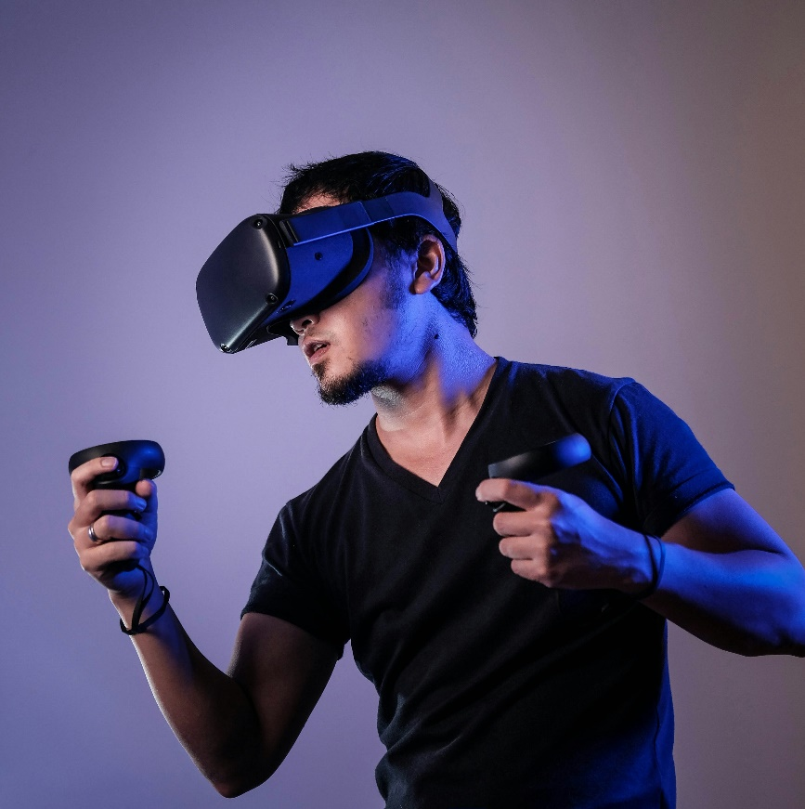
Content / Biological Topic
Before we begin
Notes:
Give a run down of who you are and what you do
I study haptic sense perception at the Dr. Laurence Harris Lab (psych prof really)
This means I study a lot of, how do people understand and process what they touch, and ONLY what they touch, not what they SEE and TOUCH. That isn’t me
I plan to study haptic perception mainly in the hands, but I want to be able to study it across the body and across space and MAYBE lower appendages (maybe). -> ill get back to this
The purpose of this work, for those who are curious is to develop better VR and AR experiences and make these systems for the future more refined and better suited for human use and exploration.
Or if not applicable there, then we can at least develop treatments and more advanced methodologies in diagnosing diseases or better assessments of human ability for various hand based experinces. Like, how well can your doctor place a robot arm at a specific point, to consider

Slide 6
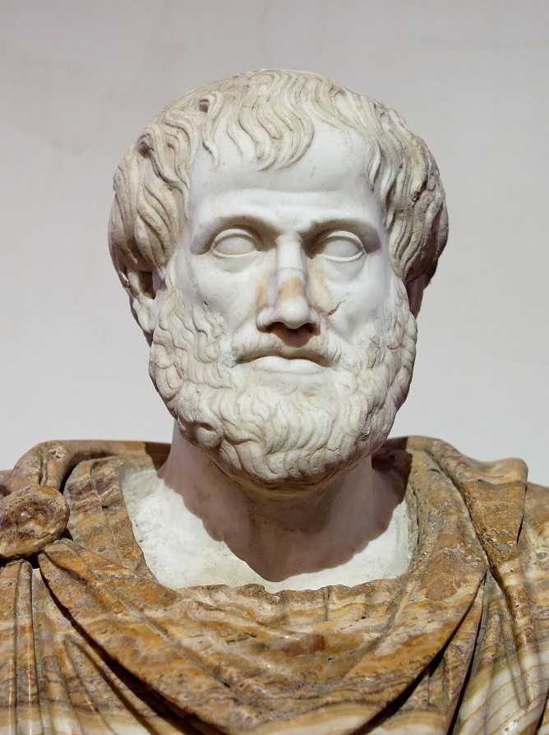
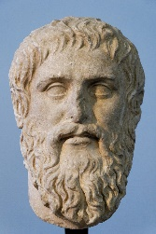
Ancient Philosophers - Sense
(Brandt et al., 2024; Gregoric & Fink, 2022)
Intellect and perception?
Plato
(430 BCE – 350 BCE)
Empiricism
Perception?
Distinction Between Sensation and Perception
Senses?
Theory of forms
Knowledge?
STARTED THE SCIENCE/PHILOSOPHY
Aristotle (380 BCE – 320 BCE)
Notes:
- go over and study these ideas
Theory of forms (we cant see real reality)
Empiricism -> sensory knowledge is what we have to study reality
-- plato was basically like, wahat is senses, what is perception, what does it mean to have knowledge of the world.

Slide 7

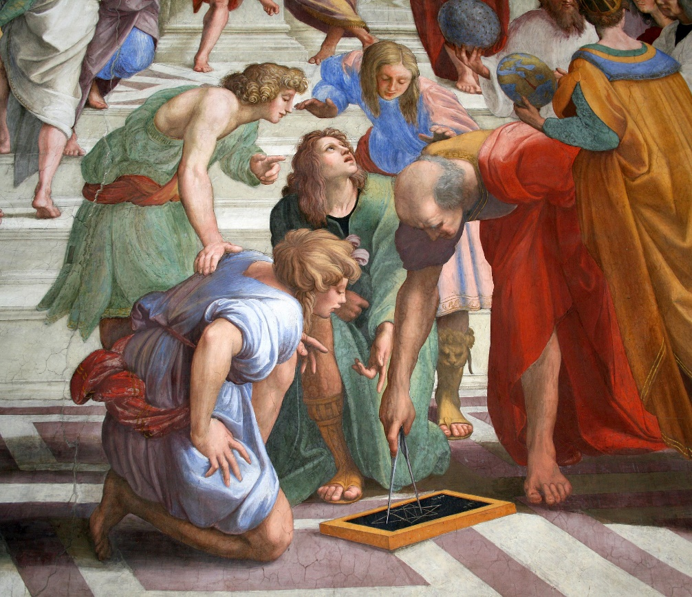
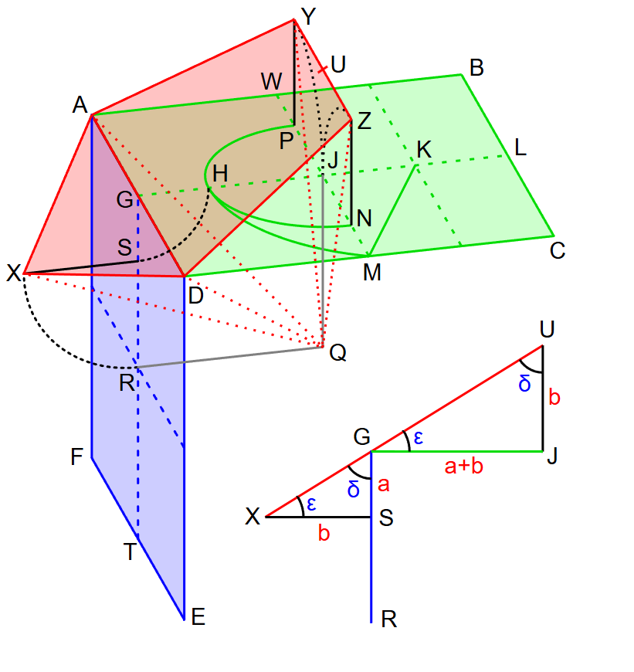
Ancient Philosophers PT.2
(Lanczos, 1970; Millar, 2008)
Defined Space
Worked on size/distance perception
Euclid
(300 BCE)
300 BCE -> 1600s
- lots of physiology work
Notes:
Next we have Euclid, and im only covering really important people and ideas, or people who will be reference a lot later on,
Eculid is the most amazing vcuz he defineid and made the concept of euclidan space real, and something that we can discuss and work around / with
Ibn al-haytham, he came almost 1000 years later but was the first studier of optics, geometrically and also of human vision and biology, showing here the optic chasm
The reason I skipped 1300 years is cuz, there isn’t much too important, even tho this is a deep histoy, a lot of the elemnts im explaning now are relelvant to what im going to say, instead of relelavnt to psyophysics, biological psychology etc

Slide 8
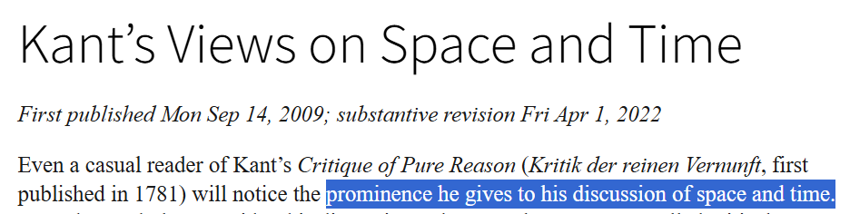
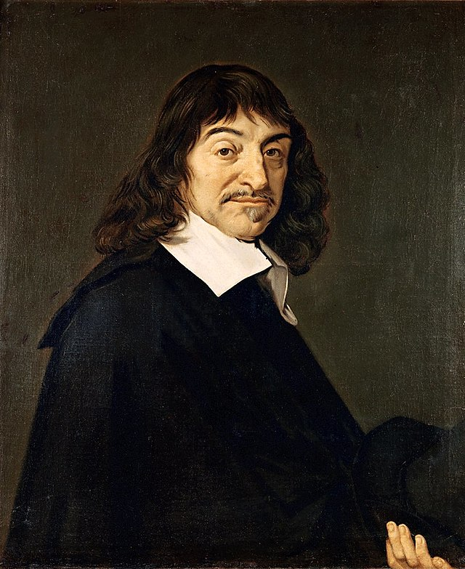
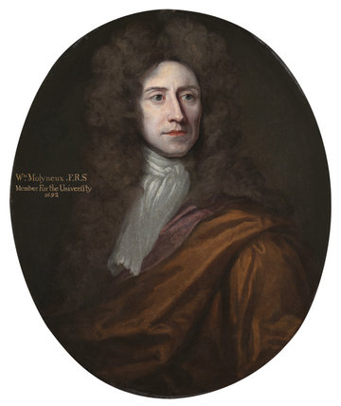
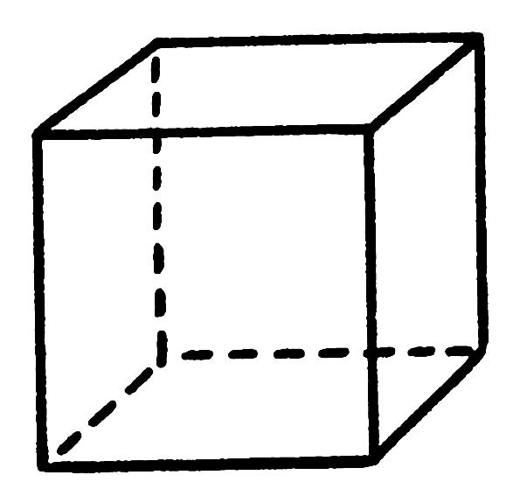
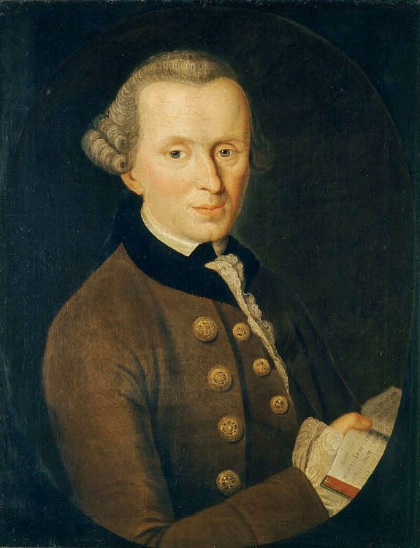

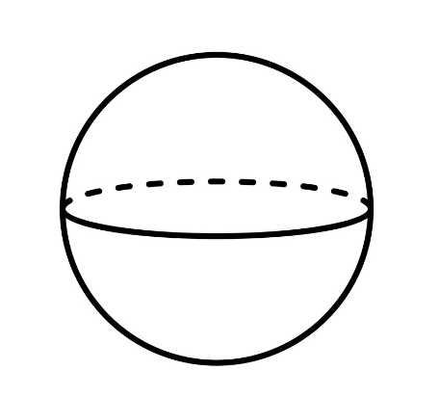
Pre Scientific revolution (1600s) – 1800
(Brandt et al., 2024; Gibson, 1987; Gregoric & Fink, 2022; Kant’s Views on Space and Time (Stanford Encyclopedia of Philosophy), n.d.; Mach, 1960)
René Descartes (1596–1650)
Empiricism
William Molyneux (1656–1698)
Start of the
Scientific method
Immanuel Kant
(1724–1804)
Notes:
Relate back to science please -> scientific method started here + psychologyical foundcations

Slide 9
Pre Scientific revolution – 1800
PEOPLE STARTED TO THINK
WHAT ARE SENSES
WERE THE GREEKS RIGHT?
WHAT IS KNOWLEDGE?
WHAT IS …
Notes:
Relate back to science please -> scientific method started here + psychologyical foundcations

Slide 10
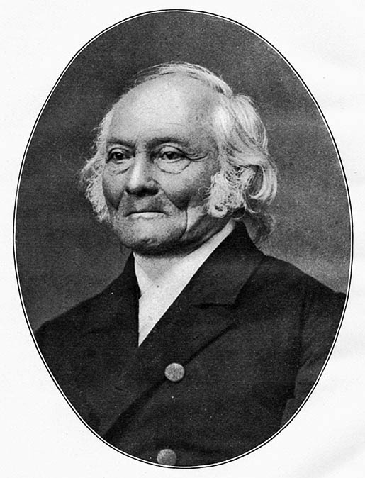
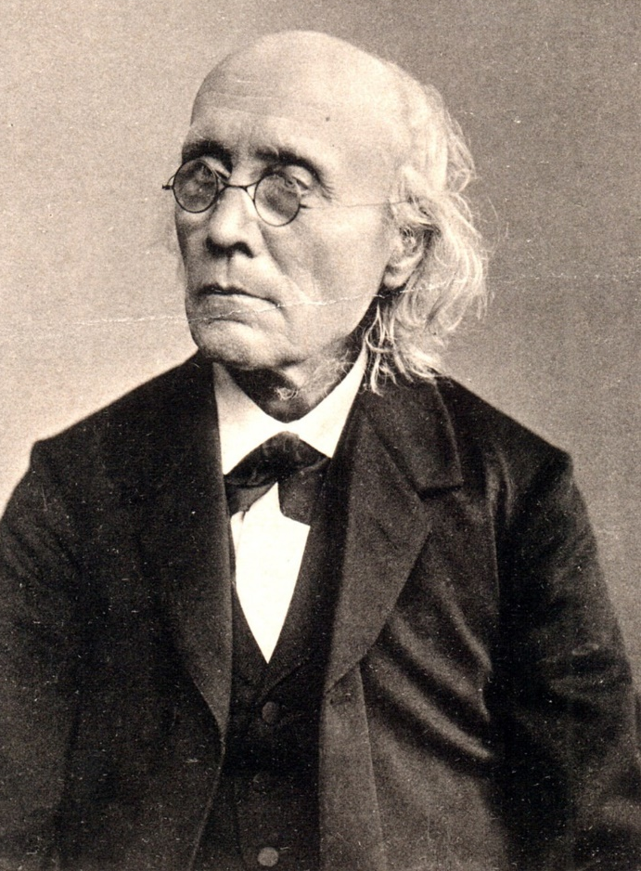
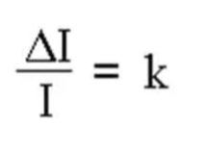
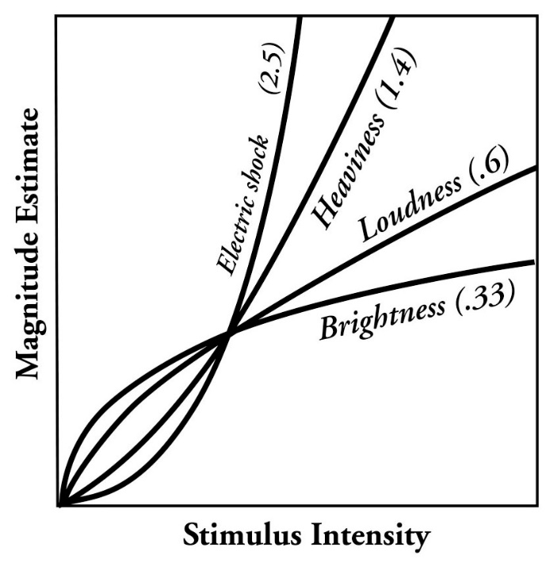
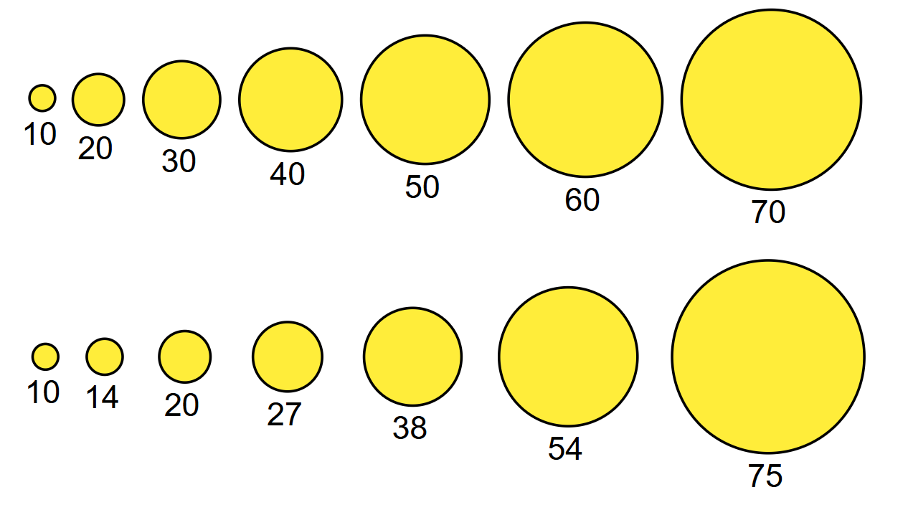
1800s Onwards – PSYHOPHYSICS! WHAT IS PERCEPTION?
(Weber, 1834; Zhou et al., 2024)
Fechner’s Law
The two-alternative forced-choice (2AFC) paradigm
Ernst Heinrich Weber (1795–1878)
JND
Weber’s Law
Gustav Fechner (1801–1887)

Slide 11
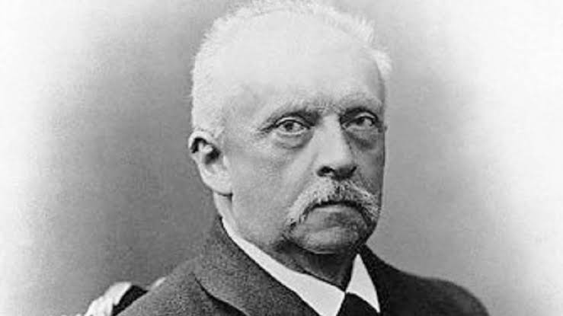
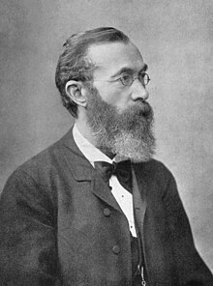
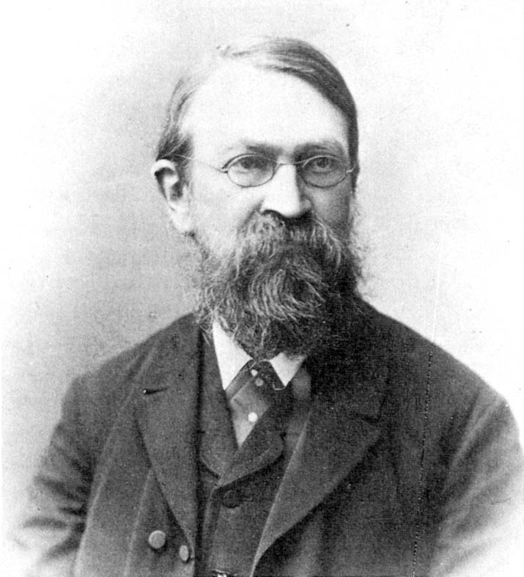
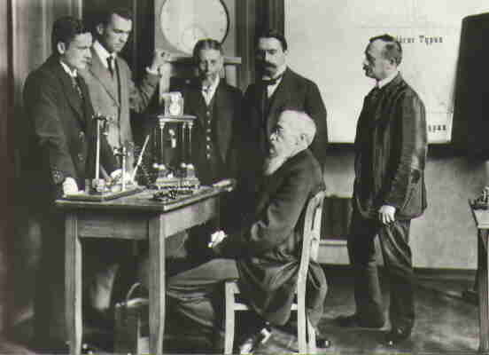
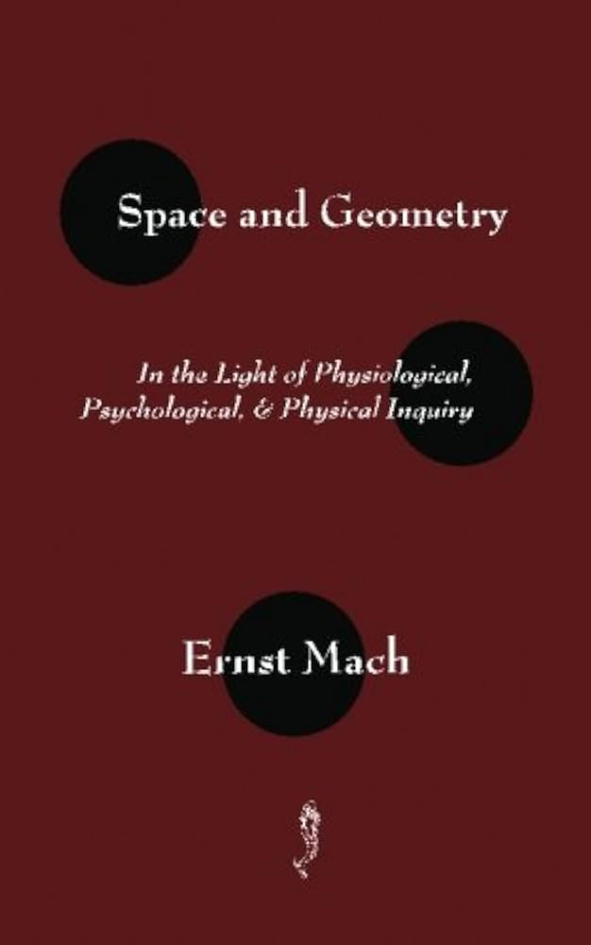
1850s onwards
(Skrodzki, 2020; Wagner, 2006)
Hermann von Helmholtz (1821–1894)
3. Physiological
Sense Perception Research
Physiology
Wilhelm Wundt (1832–1920)
Psychological Labs
Formal Procedures and definition of the field
Ernst Mach (1838–1916)
Behaviorism/Psychology
Philosophy/Math
Notes:
Hermann von Helmholtz (1821–1894) -> started the idea of brain responds to stimuli
Ernst Mach -> started the philosophy of space and perception, lots of physics
Wilhelm Wundt -> further refined psychology

Slide 12
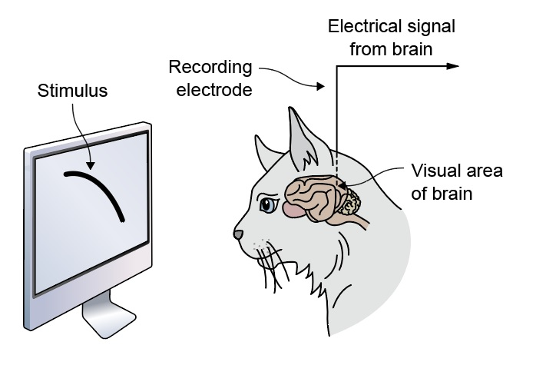

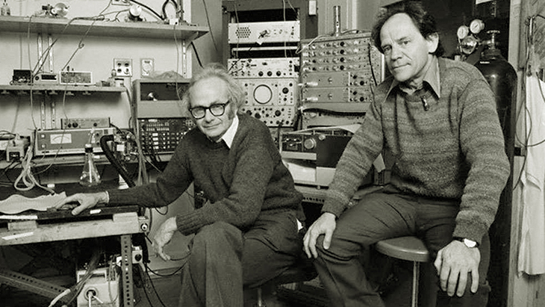

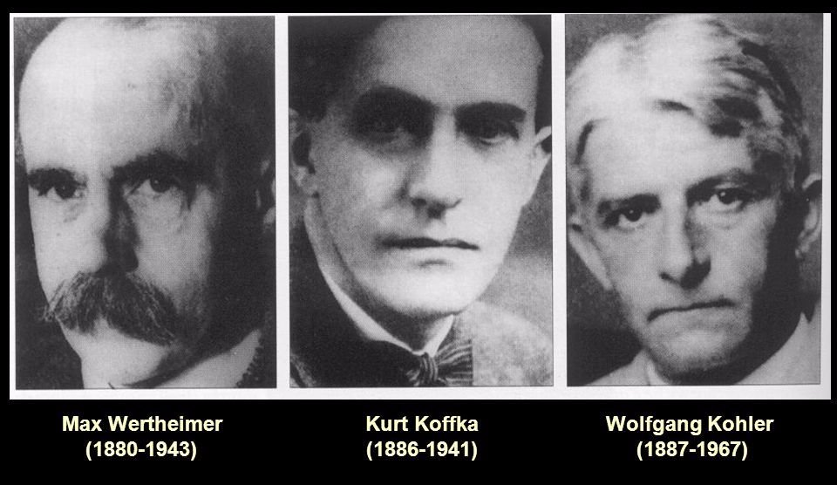
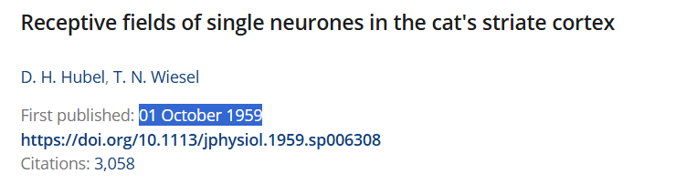
1900s-1950s onwards
Gestalt Psychology
Connecting Psychology and Physiology
Physiology
Behaviorism/Psychology
(Albert, 1993, 1993; D H Hubel & T N Wiesel, 1959; Patton, 2018; Wertheimer, 1923)
Notes:
Just talk about the explosion in psychological theories
William james -> made proper psychological principles
Werthermier, Koffa, Kholer all made Gestalt Psych
These 2 were very sense perception based
2 key figures that looked at everyone and, this is regular psych but important
John B Watson and BF Skinner, they worked on behavirosm, and the idea these 2 men worked on is, IF WE SEE SOMETHING, WE DO SOMETHING, now that sounds like a no brainer, but they really worked out the idea,
IF WE SEE A VERY PATICULAR THING, WE HAVE A VERY PATICTULAR RESPOSNE

Slide 13


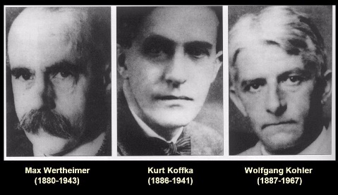
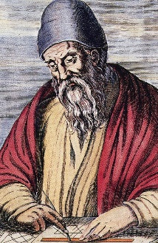

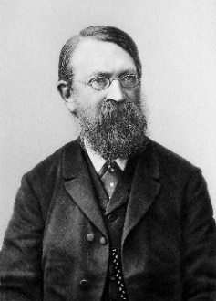
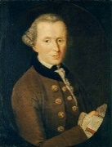
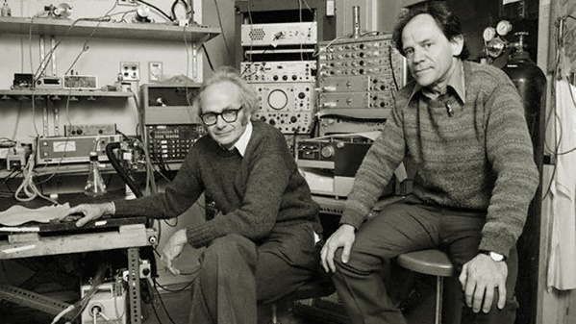

1900s-1950s onwards
Behaviorism/Psychology
Philosophy/Math
Physiology

Slide 14
1950s-1999
Behaviorism/Psychology
Biology
Philosophy / Math
Computers
Physiology
Notes:
2 big variants of this come out

Slide 15
1950s-1999
Biology
Computers
Notes:
2 big variants of this come out

Slide 16
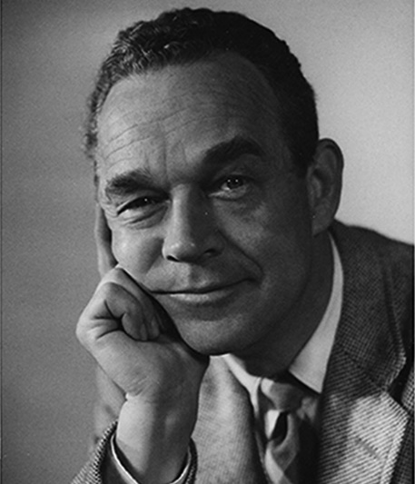
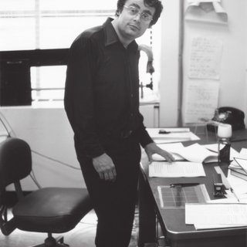
1950s-1999
Biology &
Psychology
J.J Gibson
Brain’s Algorithms
David Marr
Notes:
2 big variants of this come out

Slide 17
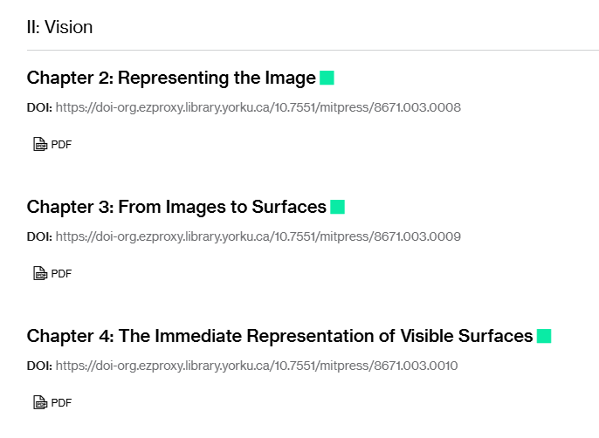
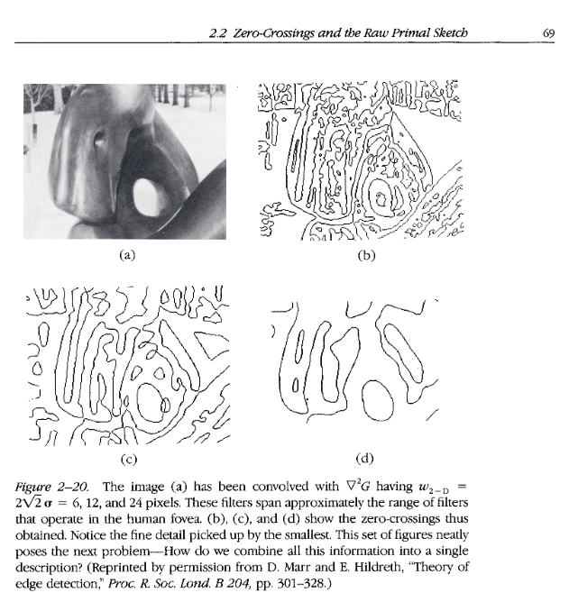
1950s-1999
Worked on the idea of a sketch in the brain
Understood basics of brain processing*
Biology &
Psychology
Einstein of neuroscience
Brain’s Algorithms
David Marr
(David Marr, 1982)
Notes:
Helped make the study of the brain, defined the idea of a primal sketch in the brain

Slide 18
1950s-1999
Biology &
Psychology
J.J Gibson
Brain’s Algorithms
David Marr
Notes:
2 big variants of this come out

Slide 19
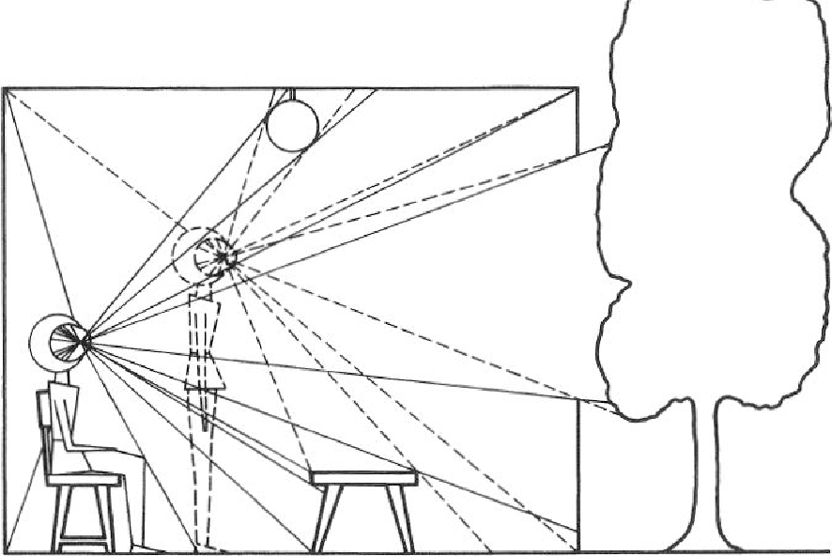
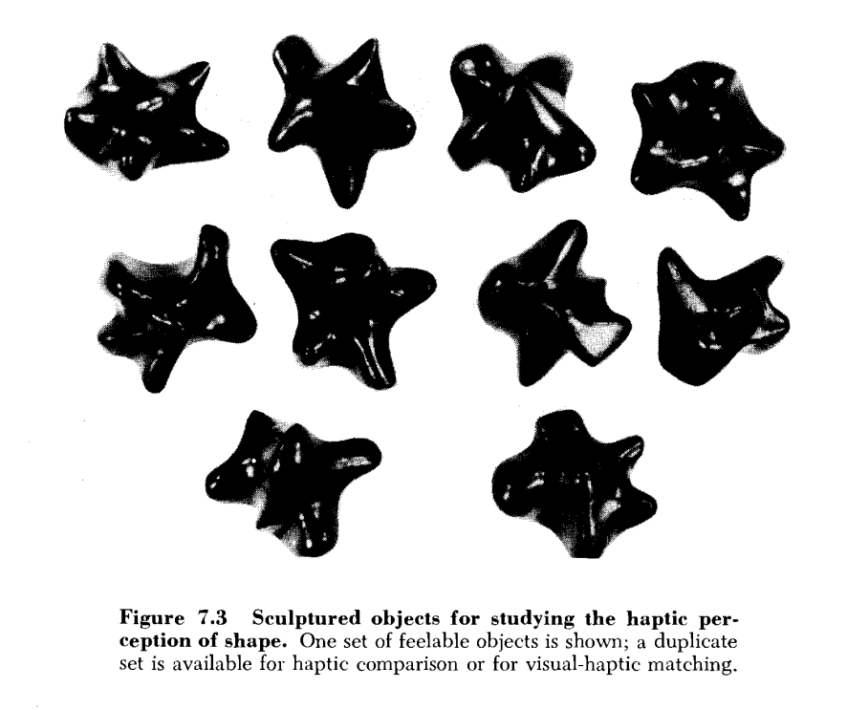
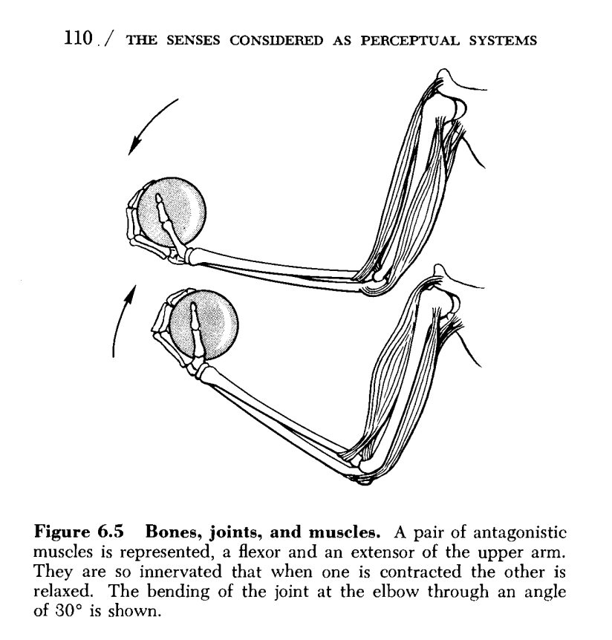
1950s-1999
Ecological Optics
Combined psychology, neuroscience, and physiology
Invariants
(Gibson, 1969, 1987)
Biology &
Psychology
J.J Gibson
Brain’s Algorithms
Joint and Muscle Positions
Haptic System/Sense
Skeletal Space/Kinesthesis
Passive Touch vs Active Touch
Notes:
2 big variants of this come out

Slide 20
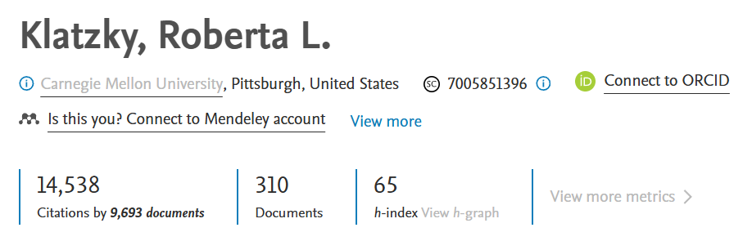
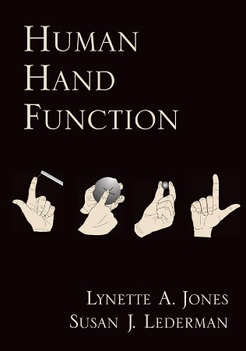
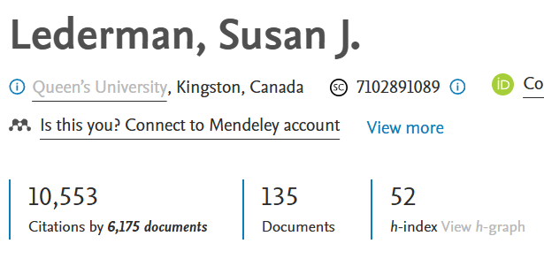

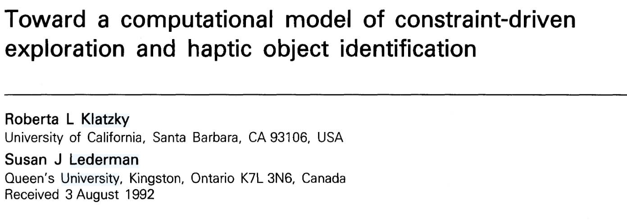
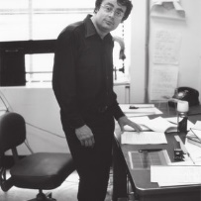
1950s-1999
(Klatzky & Lederman, 1993)
Biology
Psychology
J.J Gibson
Brain’s
Algorithms
David Marr

Slide 21
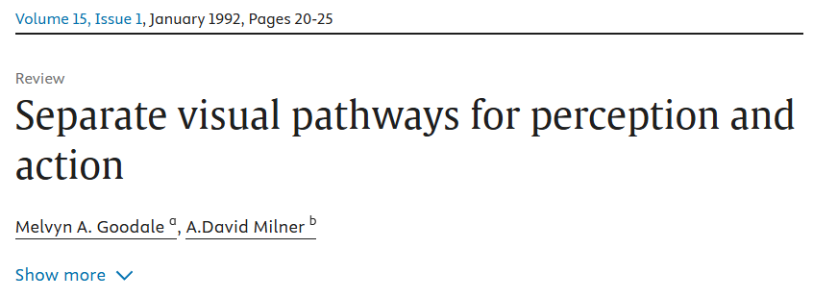
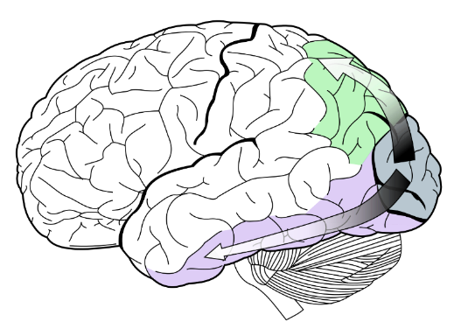
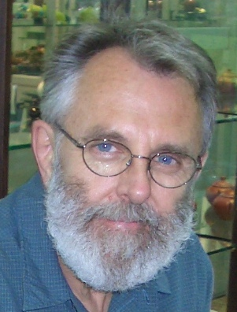
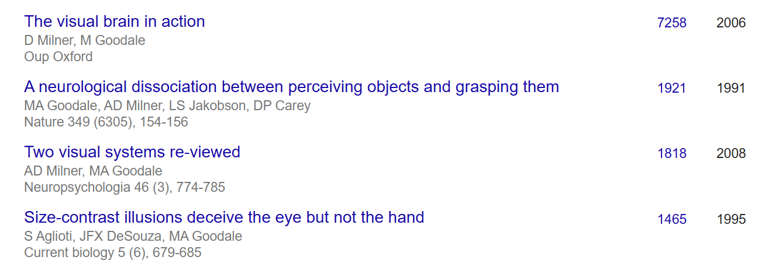
1950s-1999
(Goodale & Milner, 1992; Melvyn A. Goodale & G. Keith Humphrey, 1998)
Biology
Psychology
J.J Gibson
Brain’s
Algorithms
David Marr

Slide 22

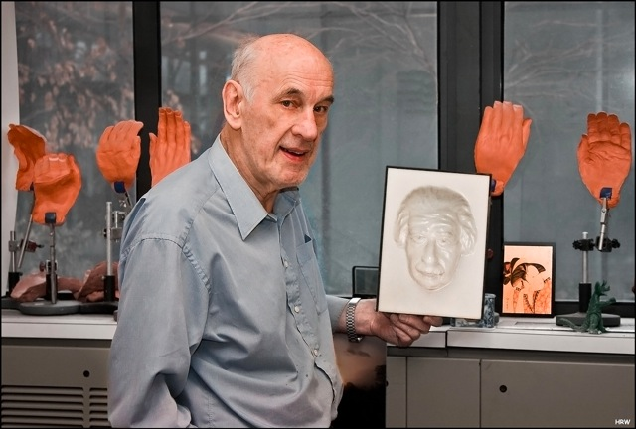
2000s-Present

Slide 23
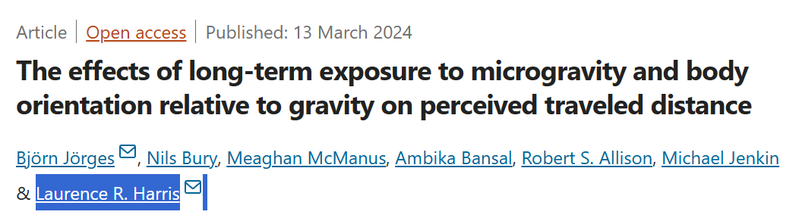

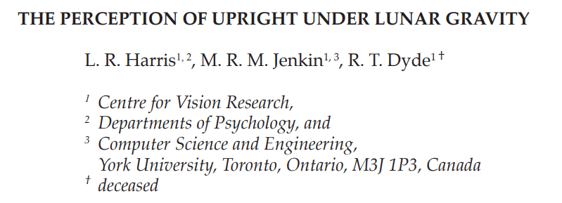
2000s-Present
Haptics?
A Final Passion Project

Slide 24
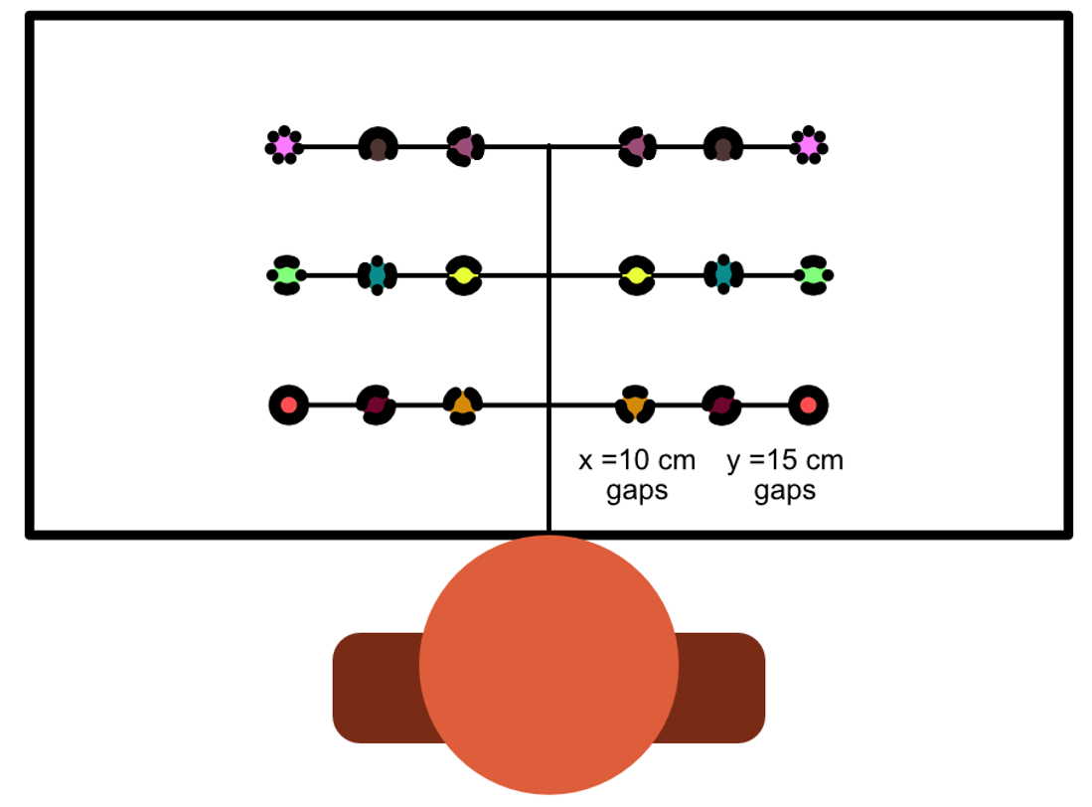



2000s-Present

Slide 25



2000s-Present

Slide 26
2000s-Present

Slide 27

2000s-Present

Slide 28












2000s-Present
🍎

Slide 29
References
Albert, M. K. (1993). Parallelism and the Perception of Illusory Contours. Perception, 22(5), 589–595. https://doi.org/10.1068/p220589
Brandt, T., Dieterich, M., & Huppert, D. (2024). Human senses and sensors from Aristotle to the present. Frontiers in Neurology, 15, 1404720. https://doi.org/10.3389/fneur.2024.1404720
D H Hubel & T N Wiesel. (1959). Receptive fields of single neurones in the cat’s striate cortex—PMC. https://pmc.ncbi.nlm.nih.gov/articles/PMC1363130/
David Marr. (1982). ‎Vision. https://books.apple.com/us/book/vision/id1521739041
Gibson, J. J. (1987). The Perception of Visual Surfaces.
Goodale, M. A., & Milner, A. D. (1992). Separate visual pathways for perception and action. Trends in Neurosciences, 15(1), 20–25. https://doi.org/10.1016/0166-2236(92)90344-8
Gregoric, P., & Fink, J. L. (2022). Introduction Sense Perception in Aristotle and the Aristotelian Tradition. Brill. https://doi.org/10.1163/9789004506077_003

Slide 30
References
James J. Gibson. (1969). The Senses Considered as Perceptual Systems. Rukin House, 44(1), 104–105. https://doi.org/10.1086/406033
James, W. (1887). The Perception of Space. (I.). Mind, 12(45), 1–30.
Johnson, M. R. (2011). Spatial Cognition, Spatial Perception. The Yale Journal of Biology and Medicine, 84(1), 63.
Kant’s Views on Space and Time (Stanford Encyclopedia of Philosophy). (n.d.). Retrieved November 6, 2024, from https://plato.stanford.edu/entries/kant-spacetime/
Killeen, P. (2019). The Behavioral Psychophysics of SS Stevens.
Klatzky, R. L., & Lederman, S. J. (1988). The Intelligent Hand. In G. H. Bower (Ed.), Psychology of Learning and Motivation (Vol. 21, pp. 121–151). Academic Press. https://doi.org/10.1016/S0079-7421(08)60027-4
Klatzky, R. L., & Lederman, S. J. (1993). Toward a Computational Model of Constraint-Driven Exploration and Haptic Object Identification. Perception, 22(5), 597–621. https://doi.org/10.1068/p220597

Slide 31
References
Lanczos, C. (1970). Space through the Ages The Evolution of Geometrical Ideas from Pythagoras to Hilbert and Einstien (Vol. 30). Academic Press London and New York.
Lederman, S. J., & Klatzky, R. L. (2007). New directions in touch. Canadian Journal of Experimental Psychology / Revue Canadienne de Psychologie Expérimentale, 61(3), 169–170. https://doi.org/10.1037/cjep2007017
Mach, E. (1960). Space and Geometry in the Light of Physiological, Psychological and Physical Inquiry (T. J. McCormack, Trans.). Cambridge University Press. https://doi.org/10.1017/CBO9781107338449
Melvyn A. Goodale & G. Keith Humphrey. (n.d.). The objects of action and perception—ScienceDirect. Retrieved November 4, 2024, from https://www.sciencedirect.com/science/article/pii/S0010027798000171
Millar, S. (2008). Space and Sense. Psychology Press. https://doi.org/10.4324/9780203938645
Patton, L. (2018). Helmholtz’s physiological psychology 1. In S. Lapointe (Ed.), Philosophy of Mind in the Nineteenth Century (1st ed., pp. 96–116). Routledge. https://doi.org/10.4324/9780429508134-6
R. Steven Turner. (1994). In The Eye’s Mind. Princeton University Press.

Slide 32
References
Skrodzki, M. (2020). Illustrations of non-Euclidean geometry in virtual reality (No. arXiv:2008.01363). arXiv. https://doi.org/10.48550/arXiv.2008.01363
Wagner, M. (2006). The Geometries of Visual Space. Psychology Press. https://doi.org/10.4324/9780203837627
Weber, E. H. (1834). E.H. Weber on the Tactile Senses (E. R. Helen & J. M. David, Eds.; 2nd ed.). Psychology Press. https://doi.org/10.4324/9781315782089
Wertheimer, M. (1923). Investigations on Gestalt Principles.
Zhou, J., Duong, L. R., & Simoncelli, E. P. (2024). A unified framework for perceived magnitude and discriminability of sensory stimuli. Proceedings of the National Academy of Sciences, 121(25), e2312293121. https://doi.org/10.1073/pnas.2312293121

Slide 33
References OF IMages
Links point to images, and are ordered in order of appearance of the slide deck: (all images were in the public domain and followed proper copyright agreements):
https://en.wikipedia.org/wiki/Plato#/media/File:Plato_Silanion_Musei_Capitolini_MC1377.jpg
https://upload.wikimedia.org/wikipedia/commons/a/ae/Aristotle_Altemps_Inv8575.jpg
https://en.wikipedia.org/wiki/Euclid#/media/File:0_Chambre_de_Rapha%C3%ABl_-_%C3%89cole_d'Ath%C3%A8nes_-_Mus%C3%A9es_du_Vatican.JPG
https://en.wikipedia.org/wiki/Euclid#/media/File:Euclid_Dodecahedron_1.svg (no changes made to original image)
https://en.wikipedia.org/wiki/Ren%C3%A9_Descartes#/media/File:Frans_Hals_-_Portret_van_Ren%C3%A9_Descartes.jpg
https://en.wikipedia.org/wiki/William_Molyneux#/media/File:William_Molyneux_-_Kneller.jpg
https://en.wikipedia.org/wiki/Immanuel_Kant#/media/File:Immanuel_Kant_-_Gemaelde_1.jpg
https://en.wikipedia.org/wiki/Ernst_Heinrich_Weber#/media/File:Ernst_Heinrich_Weber.jpg
https://wikimedia.org/api/rest_v1/media/math/render/svg/aba5c17d611ef62e9acce27266caab0ec1e7c6ed
https://en.wikipedia.org/wiki/Just-noticeable_difference#/media/File:Weber-Fechner_law_demo_-_circles.svg (no changes made to the original image)

Slide 34
References OF IMages
Links point to images, and are ordered in order of appearance of the slide deck: (all images were in the public domain and followed proper copyright agreements):
https://www.psywww.com/intropsych/ch04-senses/psychophysics.html
https://en.wikipedia.org/wiki/Wilhelm_Wundt#/media/File:Wilhelm_Wundt.jpg
https://en.wikipedia.org/wiki/Wilhelm_Wundt#/media/File:Wundt-research-group.jpg
https://en.wikipedia.org/wiki/Ernst_Mach#/media/File:Ernst_Mach_01.jpg
https://en.wikipedia.org/wiki/Hermann_von_Helmholtz#/media/File:Hermann_von_Helmholtz.jpg
https://www.gestalttherapyblog.com/blog/max-wertheimer
https://m.media-amazon.com/images/I/31Z0Jj5cp7L._AC_UF1000,1000_QL80_.jpg
https://definingmomentscanada.ca/wp-content/uploads/2022/09/img_EP_hubel-weisel-toys2-1.jpg
https://definingmomentscanada.ca/wp-content/uploads/2022/09/Hubel-Experiment.jpg - Courtesy of Probabilistic Deep Learning with Python by Oliver Dürr, Beate Sick, and Elvis Murina.
https://tr.wikipedia.org/wiki/James_J._Gibson#/media/Dosya:JeremyGibson.jpeg
https://www.researchgate.net/publication/235626691_The_Vision_of_David_Marr
https://en.wikipedia.org/wiki/Melvyn_A._Goodale#/media/File:Photo_of_Melvyn_Goodale_taken_in_2008.jpg (no changes made to the original image)
https://qbi.uq.edu.au/brain/brain-functions/visual-perception

Slide 35
References OF IMages
Links point to images, and are ordered in order of appearance of the slide deck: (all images were in the public domain and followed proper copyright agreements):
https://en.wikipedia.org/wiki/Ian_P._Howard#/media/File:Ian-&-Einstein.jpg
https://health.yorku.ca/health-profiles/index.php?mid=4469
https://www.freepik.com/premium-vector/tree-branch-clipart-vector-icon-sticker-illustration_249711125.htm#fromView=keyword&page=1&position=12&uuid=b46218e8-1cda-470b-84f2-05838d148c1a

Slide 36
🍎
Any questions?

